Slide 1
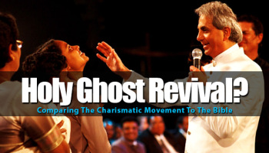
Notes:
The charismatic movement is one of the fastest growing religious movements in the world. There is a great appeal even on the part of Christians toward this movement and what it offers. Places like Brazil that used to be predominantly Catholic are now becoming predominantly charismatic. In this lesson, we will learn how the Charismatic movement developed as well as discuss how we can help those caught in its clutches to find true New Testament Christianity.

Slide 2
Origin
Wesley’s 1st work of grace
Forgiveness from sins
Justified by faith alone
Wesley’s 2nd work of grace
Gradual or instantaneous holiness
Cleansed of tendency to commit sin
2nd work of grace emphasized
Wesylans and Non-Wesylans
Mysticism & Emotionalism followed
Notes:
The beginning of the holiness movement finds its roots in Methodism and Wesley’s teaching on the 2nd work of grace. Wesley taught that the Christian experiences two sanctifications in his life. He taught the first sanctification is the result of justification by faith alone in Christ. He believed that this is when a person receives forgiveness of since and officially becomes a Christian. However, he also taught a 2nd sanctification occurred during the Christian’s life that could be either gradual or instantaneous. He believed that with this reconciliation came holiness and a ceasing of the tendency to commit sin.
The Holiness Movement came about when certain individuals began stressing Wesley’s 2nd work of grace and claiming it must be instantaneous. Men and women from a variety of denominations began to be drawn toward mysticism and emotionalism in attempting to uphold and revolutionize Wesley’s theory.

Slide 3
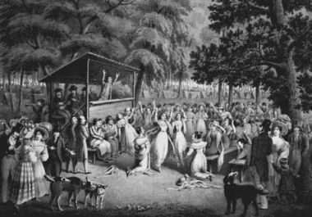
Origin
Second Great Awakening
Leaders arose claiming they had been baptized by the Holy Spirit
Associated this baptism with Wesley’s 2nd work of grace
Thousands flocked to these “evangelists” believing they had the secret to holiness
Eventually, some “charismatics” taught you could not be saved w/o HS baptism
HS baptism was proved by the gifts of the Spirit, primarily speaking in tongues
Those desiring this “salvation” had to pretend they had these gifts so as not to feel left out
Result: thousands of false conversions that turned 19th century Christianity into nothing more than mysticism and emotionalism
Notes:
During the Second Great Awakening, some started claiming a baptism of the Holy Spirit, identifying this baptism with Wesley’s second work of grace. These evangelists began revivals where they drew people with great emotionalism and promises of Holy Spirit baptism to all who believed. Eventually, some arose who claimed you could not be saved without this baptism of the Holy Spirit, proven by the gift of speaking in tongues. Many waited for this sincerely but when they did not receive it, they faked it. Others followed suit as not to be seen as being left out. This resulted in thousands and thousands of false conversions as 19th century Christianity began to be turned into nothing more than mysticism and emotionalism.

Slide 4
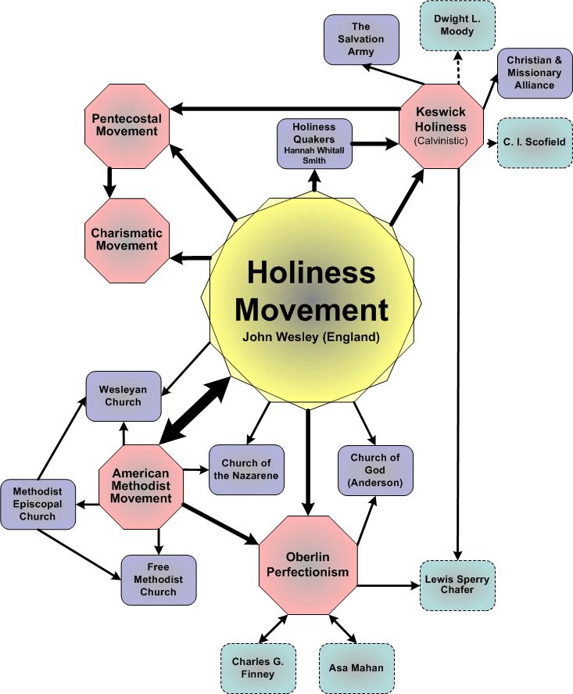
Origin
Many denominations sprang from the Holiness Movement
Pentecostal Movement
Charismatic Movement
Church of God
The Salvation Army
Church of the Nazarene
Holiness Quakers
All of these denominations have in common a belief in instantaneous regeneration that perfects the individual
Notes:
Many of our modern denominations sprang from the holiness movement:
Pentecostal Movement – these are individuals who believe that the spiritual gift of tongue speaking is evidence of conversion. Therefore, anyone who hasn’t manifested this sign in their personal life is not truly a Christian. This has caused many with honest hearts to fake this gift lest they admit they cannot become Christians.
Charismatic Movement – these are individuals who don’t believe that spiritual gifts are a sign of conversion, but do believe that God picks certain individuals to manifest these signs. Charismatics come from many different denominations including Catholics, Episcopalians, Reformed Churches, Lutherans, Seventh-Day Adventism, etc.
Church of God – these are individuals who departed the Methodist Church to further propagate the doctrine of perfectionism in the life of the Christian. They believe those whom are baptized by the Holy Spirit are perfected in their love and holiness as a result of the help of the Spirit.
The Salvation Army – Started by William and Catherine Booth who departed the Methodist Church to focus their efforts on benevolent ministries to the poor.
The Church of the Nazarene – This was started by Phineas Bresee as a result of being dissatisfied with the Methodist church. While originally called the Pentecostal Church of the Nazarene, they dropped the word “Pentecostal” later on.
Holiness Quakers – These are Quakers who believe in Wesley’s second work of grace and try to teach others to aspire for that moment of holiness where one loses the tendency toward sin.

Slide 5
Questions For Charismatics
Does the same Holy Spirit move a Baptist to be a Baptist, a Catholic to be a Catholic, a Lutheran to be a Lutheran, and a Pentecostal to be a Pentecostal?
1 Cor 12:4 – “Now there are varieties of gifts, but the same Spirit.”
Whatever gifts were to be possessed here at Corinth were to be done so in unity and harmony – 1 Cor 12:25
While there are a diversity of gifts, nowhere the does the bible say or imply that there are a diversity of teachings
The only correct teaching is the Apostle’s Doctrine (Acts 2:42) which is the foundation the church is built on (Eph 2:20) and contains only one faith (Eph 4:5)
Conclusion: The same Spirit cannot be leading all these people toward different religions and doctrines – 1 Cor 14:33
Notes:
Charismatics come in all forms. There are Catholics who are charismatic, Lutherans who are charismatic, etc. All claim to have the Holy Spirit. And yet we all recognize that there are extreme and profound doctrinal differences between these religious groups - from what a person must do to be saved even to the nature of God Himself. Therefore, does the same Holy Spirit move all of these people to have all of these different beliefs? Every honest charismatic must face this question.
1 Cor 12:4 makes it clear that while there are a variety of gifts, there is the same Spirit. Also, Paul makes the point that in using these gifts the church is to be in harmony and in unity with no divisions (1 Cor 12:25). Therefore, how can the same Holy Spirit be delivering a diversity of teachings to all these religious groups? There is no verse that says or even implies that He would do so. There is only one teaching that the bible says is right and that is the Apostles Doctrine (Acts 2:42; Eph 2:20).
Therefore, the same Spirit cannot be leading all these different people toward different religions and doctrines because God is not a God of confusion. There must be another spirit leading men and women in these profoundly different directions other than God.

Slide 6
Questions For Charismatics
Do the claims of miracles by different religions prove or disprove the validity of their claim?
The Witch Doctor, the Catholic, the Pentecostal, and the Shaman all claim miracles and expect us to accept the validity of his claim
However, none will perform the miracle on the spot on request and none will hold a contest to prove who is legitimate – Ex 7:9-12; 1 Kings 18:30-39
When questioned, we are accused of being unbelievers. Yet the purpose of miracles is repeatedly stated as being for unbelievers in order to confirm the truth – Mark 16:20; Heb 2:4; 1 Cor 14:22
So-called miracle workers would have us to accept their claim despite any evidence. In which arena of life does that ever work?
Conclusion: The same Spirit cannot be testifying with all of these individuals who teach profoundly different doctrines
Notes:
Catholics make claims to miracles. Pentecostals make claims to miracles. The Shaman in the South American jungle claims miracles. Does the fact that these different individuals with profoundly different religions prove or disprove the validity of their claim? What is interesting is that none of these individuals will perform a miracle on the spot and none of these individuals will hold a contest to see who is legitimate and who is not. We are supposed to blindly accept their claim. Even in the Old Testament, we see God’s faithful pitted against unbelievers – Moses’ staff that turned in a serpent swallowed the serpents of the fake magicians (Ex 7:9-12) and Elijah proved that Jehovah was greater the Baal on Mt. Carmel (1 Kings 18:30-39). Why not get these individuals together and find out who, if any, are true miracle workers?
Often when challenged or asked to perform a miracle, we are accused of being unbelievers. Yet the purpose of miracles as stated by the Holy Spirit Himself was to be a sign for unbelievers – Mark 16:20; Heb 2:4; 1 Cor 14:22. But so-called miracle workers suggest they are only for believers. Who should I believe? God and His word or people who claim something they cannot prove? Accepting something without evidence does not work in any arena of life, but so-called miracle workers would have us to accept their claim without evidence when there are eternal consequences attached.

Slide 7
Questions For Charismatics
What will you do when the bible contradicts one of your miracles or revelations?
God taught that His word holds more power than even miracles – Deut 13:1-5; 1 Cor 13:9-12
The miracles that confirmed the bible were greater than the “miracles” of modern day charismatics
This is why Paul could tell us that even the word of an angel that contradicts the gospel they delivered should be rejected – Gal 1:6-9
The OT claimed it would be replaced by new revelation (Jer 31:31-34) but the NT claims it would never be replaced (Jude 3)
Conclusion: We are to accept the bible above any “experience” we believe we may have had – 1 Tim 3:16-17
Notes:
Often when a charismatic is shown his error from the bible, he will put more stock in his experience than he will God’s word. This is something that the bible itself cautions against. In Deut 13, God warned the Israelites not to listen to any prophet who performs a miracle if after he does he advises violating what God’s word already stated. He was God’s way of testing them to see if they would trust His word more than a so-called miracle or experience. In 1 Cor 13:9-12, when Paul makes it clear miracles would cease when the perfect word came, we also see God’s desire is for the word to be the medium by which men would have saving faith and not miracles. In other words, God wants us to place more stock in His word than even a so-called miracle or experience we have had. Else, why would Paul warn us against even listening to an angel if he teaches another gospel?
Interestingly, miracles were used to confirm God’s word in even the OT. When God gave the 10 Commandments, He did so also testifying of its validity through the awesome scene that occurred on Mount Sinai. Therefore, the Israelites knew that the law Moses wrote during that occasion was true and could not added to or taken away. The NT also claims it cannot be added to or taken away. Then how can we be sure there is no new revelation that God will give charismatics that will contradict God’s word? Because in the OT, God claimed it would eventually be replaced by a better covenant (Jer 31:31-34). However, in the NT God states explicitly in Jude 3 that it is the faith once and for all delivered to the saints.
The conclusion is this: God wants us to accept the bible above any experience we believe we may have had, whether something that occurred in us or by someone else. 1 Tim 3:16-17 tells us that it is scripture that equips us for every good work, not miracles. We need to put our faith and trust in God’s word and not in any experience or so-called miracle.

Slide 8
Questions For Charismatics
How will you, a charismatic, protect yourself from deception?
Since each charismatic believes the claim of a miracle is evidence itself, he has no basis whatsoever by which to refute another
1 John 4:1 – “Beloved, do not believe every spirit, but test the spirits to see whether they are from God, because many false prophets have gone out into the world.”
How should a Charismatic do so?
2 Thes 2:11 – “For this reason God will send upon them a deluding influence so that they will believe what is false”
The charismatic unfortunately sets himself up to be deceived
Many so-called miracle workers have been exposed as frauds yet continued to mislead and reap financial reward
Oral Roberts
Peter Popoff
W. V. Grant
Benny Hinn
Conclusion: To ensure they are not deceived, Charismatics should demand objective evidence for any miraculous claim
Notes:
Since charismatics believe that their claim of a miracle is evidence itself, they have no basis whatsoever upon which to refute another person’s claims no matter how much they differ with them in doctrine. Else, on what basis should they do so? 1 John 4:1 commands all Christians to not believe every spirit but to test them. How do Charismatics do this? If the claim is the evidence, they cannot do so because many make the claim.
2 Thes 2:11 talks about God sending a deluding influence to apostates so that they will believe what is false. Because Charismatics assume a claim is evidence itself, they unfortunately set themselves up to be deceived by false teachers with carnal motives. That many false teachers have gone in the world and deceived thousands of charismatics is a well documented fact:
Oral Roberts once claimed that God told him if he could not raise $8 million for his new medical mission school, He would call him home. Though he raised the money ($1.3 million came from a dog-track owner), less than a year later he canceled the scholarships and then less than a year after that he closed to it pay off debts.
Peter Popoff became known as a preacher who could not only heal but could also reveal to people he had never met what their infirmity was. It was revealed that his wife would meet the visitors and gather their information. She would then transmit that information to him through a wireless earpiece. Though exposed as a fraud, he continues to deceive many even today.
W. V. Grant was caught in numerous lies. He lied about going to college at “Midstates Bible College”. He lied about sending an excess of money to Haiti for relief. He also claimed to heal the blind by asking them how many fingers he was holding up. But it was discovered he would lean into them and tell them which they would then repeat. Grant’s lies are legendary yet he continues to deceive many.
Benny Hinn is most of the most deceptive faith healers of all time. So fake is he that a Senate subcommittee has launched an investigation into it. None of his so-called miracles have bene verified. He ushers people on stage claiming to heal them but they have already been cured through natural means. These individuals are carefully selected while those in the audience with real diseases and defects are kept off stage.
If Charismatics are tired of being deceived by these phonies, they should demand objective evidence. But this would all but destroy their entire system which is why few have the courage to take a stand and truly follow Jesus.

